Slide 1

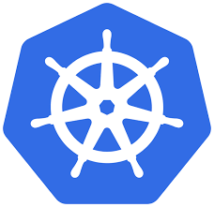
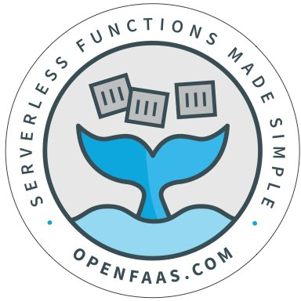


Kubernetes & openfaas apache mesos & openwhisk
Exploring container orchestration and serverless platforms for scalable and event-driven applications
Notes:
Welcome everyone to the presentation.Briefly introduce yourself and outline the topic: "We'll explore how Kubernetes with OpenFaaS and Apache Mesos are used in modern serverless and containerized applications."Mention that the session includes a case study and a live demo.

Slide 2
General information
Apache Mesos
Created By: Benjamin Hindman, Andy Konwinski, and colleagues at UC Berkeley's AMPLab.
Initial Release: 2010.
Kubernetes
Created By: Google (originally developed by Joe Beda, Brendan Burns, and Craig McLuckie).
Initial Release: June 2014.
OpenFaaS
Created By: Alex Ellis.
Initial Release: 2017.
Apache OpenWhisk
Created By: IBM (as an open-source project).
Initial Release: February 2016.

Slide 3
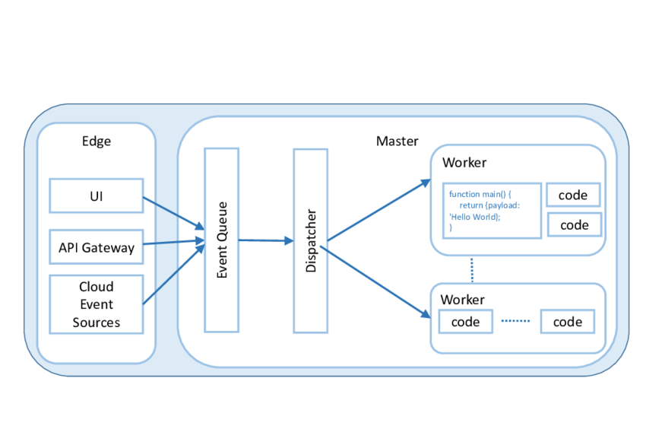
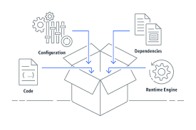
Introduction to Containers and Serverless
What is a Container ?
What is Serverless ?
Lightweight virtual environments that ensure consistent application runtime across platforms
Solve the “works on my machine” problem by bundling code, dependencies, and configurations.
Event-driven execution model where functions are deployed without explicit server management.
Scales dynamically based on demand, billing per execution or resource usage.
Notes:
Explain what containers are: "Containers package an application and its dependencies, ensuring it works consistently across different environments."Highlight how containers solve the "works on my machine" problem.Define serverless: "A computing model where developers focus on writing code while the platform manages infrastructure, scaling, and resource allocation."Benefits of serverless:Cost efficiency: Pay only for what you use.
Scalability: Automatic response to workload spikes.
Faster development cycles.
Provide a quick real-world example, e.g., a company saving costs by switching to a serverless architecture.

Slide 4
Kubernetes and OpenFaaS Overview
What is Kubernetes ?
What is OpenFaas?
Container orchestration platform automating deployment, scaling, and management.
Features: horizontal pod autoscaling, self-healing, service discovery, and rolling updates.
Example: Scaling a web app based on CPU load or user requests.
Is framework for building serverless functions on top of containers
OpenFaaS adds a serverless abstraction on Kubernetes.
Functions are accessible via REST APIs, enabling microservices architecture
Write a function → Docker container → Deploy with OpenFaaS → Kubernetes manages scaling.
Notes:
Start with Kubernetes:An orchestration platform for managing containerized applications.
Key features: self-healing, rolling updates, and scalability.
Introduce OpenFaaS:A serverless framework that runs on Kubernetes.
Makes deploying functions and existing code easy.
Explain the synergy: "OpenFaaS leverages Kubernetes' scalability and resilience to provide a flexible serverless platform."Transition: "Next, let's dive deeper into how OpenFaaS works on Kubernetes."

Slide 5
HOW KUBERNETES WORKS
Kubernetes:
  Schedules and orchestrates containers.
  The kubelet (a Kubernetes agent running on each node) uses the CRI to communicate with the container runtime (e.g., containerd).
containerd:
  Receives instructions from Kubernetes (via kubelet).
  Manages container images and container lifecycle.
  Invokes runc for creating and running containers.
runc:
  Acts as the runtime that interacts with the kernel to create the container environment.
  Configures namespaces, cgroups, and mounts for the container.
  Runs the container process in an isolated environment.
Linux Kernel:
  Provides the underlying primitives (namespaces, cgroups, chroot, etc.) to implement containers.

Slide 6
How OpenFaaS Works on Kubernetes
Key Components
Benefits
Gateway:Manages REST API endpoints and monitors scaling requirements.
Functions:Packaged as Docker containers.
Kubernetes Pods:Run function containers, scaled by the Horizontal Pod Autoscaler
Prometheus:Monitors function metrics like CPU usage, memory, and invocation counts.
No vendor lock-in: Compatible with any Kubernetes environment
Reusability: Functions are Docker containers that can run anywhere.
Notes:
Describe the architecture with a simple diagram if available.Key components:Gateway: Handles API requests and monitors functions.
Function pods: Lightweight, scalable containers running your code.
Prometheus: Used for monitoring and autoscaling.
Mention autoscaling:Explain Horizontal Pod Autoscaler (HPA) and how OpenFaaS integrates with it.
Example: "If a function's CPU exceeds a threshold, Kubernetes automatically spins up more replicas."
Summarize: "This architecture ensures reliability and scalability while keeping the development process simple."

Slide 7
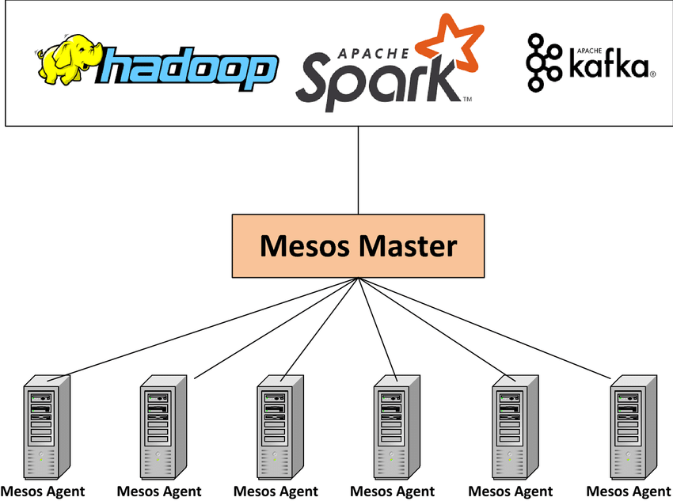
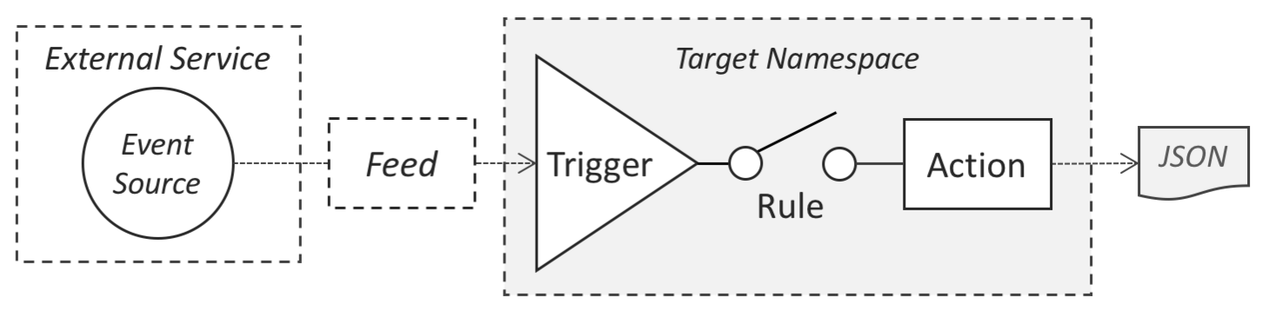
OpenWhisk & Mesos: Event-Driven Orchestration
What is Apache Mesos ?
What is Apache OpenWhisk ?
Cluster manager for resource sharing and isolation across distributed systems.
Provides the infrastructure layer for OpenWhisk.
Serverless platform for executing functions in response to events.
Integrates with event sources like Kafka, HTTP, or IoT devices.
Focus on high throughput and real-time use cases.
Notes:
Introduce Apache OpenWhisk:Event-driven serverless platform that runs functions in response to events.
Best for IoT, real-time analytics, and event processing.
Explain Apache Mesos:A cluster manager that abstracts resources across machines.
Ideal for heterogeneous workloads, such as combining big data processing with container orchestration.
Highlight the key difference:OpenFaaS focuses on simplicity and integration with Kubernetes.
OpenWhisk targets complex event-based workflows.

Slide 8
HOW MESOS WORKS
Mesos:
  Offers resource management and scheduling for containerized workloads.
  Sends tasks to executors (e.g., Mesos Containerizer, Docker) to run containers.
Mesos Containerizer or Docker:
  Handles container creation and lifecycle.
  If using Mesos Containerizer with OCI, it invokes containerd.
containerd:
  Manages container images and invokes runc for low-level operations.
runc:
  Implements the container runtime, configuring isolation and running the container process.
Linux Kernel:
  Provides the underlying mechanisms for namespaces, cgroups, and processes.

Slide 9
OpenWhisk Architecture
Key Components
Benefits
Controller: Manages triggers and routes invocation requests.
Invoker: Executes functions inside Docker containers.
Triggers and Rules: Bind event sources (e.g., Kafka topics) to functions.
Mesos:Ensures efficient resource allocation for OpenWhisk's Docker containers.
Low-latency execution.
Efficient for high-throughput workloads.
Notes:
Kubernetes:Built for microservices and containerized workloads.
Excellent for web applications, APIs, and serverless frameworks like OpenFaaS.
Mesos:Originally designed for big data workloads like Apache Spark and Hadoop.
Suitable for environments requiring resource isolation across different types of jobs.
Summary:"Kubernetes excels at managing containerized microservices, while Mesos shines in environments with diverse workload types."

Slide 10
KUBERNETES VS APACHE MESOS
Kubernetes: Think of Kubernetes as a smart city
Mesos: A flexible contractor managing a city
Self-Driving Features: Automatically fixes potholes (pod failures) and adjusts traffic flow (load balancing).
Blueprint-Based: Every building (application) is defined with precise plans (YAML files).
Utility Automation: Water (storage), electricity (CPU/memory), and traffic (networking) are centrally monitored and adjusted without human intervention.
Designed for the Future: Built specifically for modern skyscrapers (containers) and cloud applications.
Resource Distributor: Gives construction materials (CPU/memory) to different teams but lets them decide how to build.
Supports Old and New: Handles modern skyscrapers (containers) alongside older buildings (legacy applications).
Hands-Off Approach: Focuses on allocation, leaving the actual work (scheduling, repairs) to specialized subcontractors (frameworks like Marathon or Aurora).

Slide 11
Comparing Kubernetes + OpenFaaS vs Mesos + OpenWhisk
Feature | Kubernetes + OpenFaaS | Mesos + OpenWhisk
Focus | REST APIs, predictable scaling | Event-driver, real-time processing
Scalability | Kubernetes HPA | OpenWhisk dynamic event scaling
Ease of use | Simpleer YAML configs | Complex setup with Mesos
Integration | Works with CI/CD , Prometheus | IoT, Kafka , asynchronous systems
Kubernetes/OpenFaaS suits microservices and APIs.
Mesos/OpenWhisk excels in real-time, event-heavy workflows.
Notes:
Discuss operational complexity:
Kubernetes: Steeper learning curve but rich in features.
Mesos: Simpler for specific use cases, but less flexible.
Compare scaling:
OpenFaaS: Leverages Kubernetes’ autoscaling for seamless resource management.
OpenWhisk: Requires custom configuration for event-driven workflows.
Use case examples:
Kubernetes + OpenFaaS: E-commerce platform scaling to handle flash sales.
Mesos + OpenWhisk: Data pipeline processing for a financial institution.

Slide 12
Comparing Use Cases: Kubernetes vs. Mesos
KUBERNETES
MESOS
Best suited for microservices, REST APIs, and cloud-native applications.
Strong ecosystem for CI/CD pipelines and monitoring (e.g., OpenFaaS, Prometheus).
Ideal for dynamic, container-heavy workloads requiring automated scaling and rolling updates.
Excellent for heterogeneous, resource-heavy workloads (e.g., Big Data, ML pipelines).
Suitable for both containerized and traditional applications.
Focus on infrastructure-level resource optimization for large-scale distributed systems.
Kubernetes: Scaling an e-commerce website based on real-time traffic spikes.
Mesos: Running a combination of Hadoop jobs, Docker containers, and Spark ML tasks on a shared cluster.
Notes:
Explain the setup:Function deployed on Kubernetes with OpenFaaS.
Autoscaling based on CPU usage.
Walk through the scaling process:Load increases -> CPU usage spikes -> More replicas are created.
Discuss the role of Prometheus:Metrics collected for decision-making.
Example: "If CPU exceeds 50% for 1 minute, create additional replicas."
Highlight results:Improved response times and resource utilization.

Slide 13
COMPARISON OF OPENFFAS VS MANUAL SCALING
SETUP OPENFAAS
SETUP WITH BASH SCRIPT
Deploy function using OpenFaas CLI (tool that helps with the function deployment)
Configure Kubernetes HPA for autoscaling
Run a bash script to scale function based on CPU
Use a custom monitor with unix utilities
CHALLENGES
CHALLENGES
Requires Kubernetes knowledge for setup
Slight overhead in resource management
Scaling logic is manual and not fault tolerant
Limited observability and lacks native load balancing
Notes:
Set up the demo:Show both Kubernetes + OpenFaaS and Bash script approaches.
Explain the load generation and autoscaling process.
Perform the demo:Trigger load and display metrics.
Emphasize the differences in observability and automation.
Conclude with key observations:"OpenFaaS handled the traffic seamlessly, while the manual approach required constant monitoring."

Slide 14
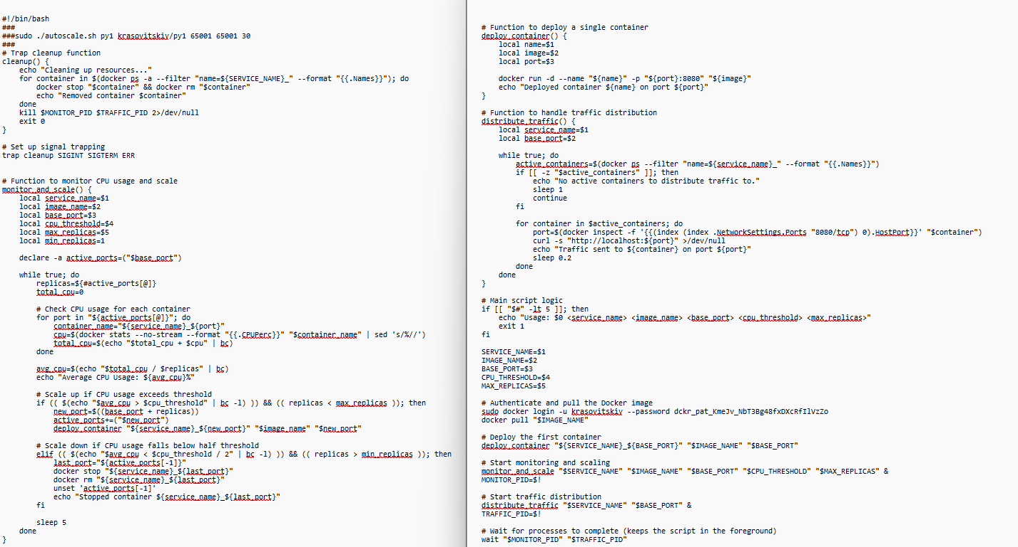
Case Study : BASH Autoscaling
Implementing Deployment and Autoscaling with Bash
Examlpe script [Very long and time consuming : ( ]
Scenario :
  Containers exposed via port mapping
  Monitors CPU usage and scale pods dynamically
Setup :
  Create a manual script that scales and runs docker containers and maps them to ports

Slide 15
LETS SETUP A CLUSTER
INSTALL MINIKUBE
INSTALL KUBECTL AND START
curl -LO https://storage.googleapis.com/minikube/releases/latest/minikube-linux-amd64
sudo install minikube-linux-amd64 /usr/local/bin/minikube && rm minikube-linux-amd64
rm -f minikube-linux-amd64
curl -LO "https://dl.k8s.io/release/$(curl -L -s https://dl.k8s.io/release/stable.txt)/bin/linux/amd64/kubectl"
sudo install -o root -g root -m 0755 kubectl /usr/local/bin/kubectl
minikube kubectl -- get po -A
minikube start

Slide 16
DEMO TIME !
Lets create a function using OpenFaas CLI to deploy on our minikube cluster
(Tool to launch Kubernetes clusters on a single node)
Lets generate some load to it and see how the containers scale
STEPS
## 1. Install Helm
curl https://raw.githubusercontent.com/helm/helm/main/scripts/get-helm-3 | bash
## 2. Alias `kubectl` for Minikube
alias kubectl="minikube kubectl --"
## 3. Install Socat & Set Up TCP Forwarding
sudo apt install -y socat
sudo socat TCP-LISTEN:31112,fork TCP:192.168.49.2:31112
## 4. Install `faas-cli`
curl -sL cli.openfaas.com | sudo sh
## 5. Apply OpenFaaS Namespaces
kubectl apply -f https://raw.githubusercontent.com/openfaas/faas
netes/master/namespaces.yml
## 1. Add OpenFaaS Helm Repository
helm repo add openfaas https://openfaas.github.io/faas-netes/
helm repo update
## 2. Set Up OpenFaaS Credentials
PASSWORD=$(head -c 12 /dev/urandom | shasum | cut -d' ' -f1)
kubectl -n openfaas create secret generic basic-auth \
--from-literal=basic-auth-user=admin \
--from-literal=basic-auth-password="$PASSWORD"
## 3. Install OpenFaaS Using Helm
helm upgrade openfaas --install openfaas/openfaas \
--namespace openfaas \
--set functionNamespace=openfaas-fn \
--set basic_auth=true
## 4. Verify Gateway Deployment
kubectl -n openfaas rollout status -w deployment/gateway
## 1. Set Environment Variables
export OPENFAAS_URL=http://$(minikube ip):31112
export OPENFAAS_PASSWORD=$(kubectl -n openfaas get secret basic-auth -o
jsonpath="{.data.basic-auth-password}" | base64 --decode)
faas-cli login --username admin --password "$OPENFAAS_PASSWORD" –gateway
"$OPENFAAS_URL"
## 2. Create a New Function
faas-cli template store pull python3-http
faas-cli new --lang python3-http --prefix=krasovitskiy py1
## 3. Build, Push, and Deploy Function
faas-cli build -f py1.yml
faas-cli push -f py1.yml
faas-cli deploy -f py1.yml --gateway "$OPENFAAS_URL"
## 4. Enable Autoscaling
minikube addons enable metrics-server
kubectl autoscale deployment py1 -n openfaas-fn --cpu-percent=30 --min=1 --max=3
Notes:
Recap:Kubernetes + OpenFaaS: Best for modern serverless applications requiring scalability and observability.
Mesos + OpenWhisk: Ideal for event-driven or big data workloads.
Key takeaway:Choosing the right stack depends on your workload and operational requirements.
Invite questions and thank the audience for their time.

Slide 17
Case Study : OpenFaas Autoscaling
Implementing Deployment and Autoscaling with OpenFaaS
Example Config for a function:
Scenario :
  Python REST API deployed with OpenFaas
  Monitors CPU usage and scale pods dynamically
Setup :
  Use OpenFaas to create a template for the function , containerize , deploy
version: 1.0
provider:
name: openfaas
gateway: http://127.0.0.1:8080
functions:
py1:
lang: python3-http
handler: ./py1
image: krasovitskiy/py1:latest
Notes:
Manual scaling:Requires human intervention, leading to delays.
Inefficient during sudden traffic spikes.
OpenFaaS:Automatically adjusts based on real-time metrics.
Provides observability with dashboards and metrics.
Show benefits using metrics or charts:"With OpenFaaS, response times dropped by 30% during peak loads."

Slide 18
Case Study : OpenFaas Autoscaling
Implementing Deployment and Autoscaling with OpenFaaS
Example Python function:
Scenario :
  Python REST API deployed with OpenFaas
  Monitors CPU usage and scale pods dynamically
Setup :
  Use OpenFaas to create a template for the function , containerize , deploy
def handle(event, context):
return {
"statusCode": 200,
"body": "Hello from OpenFaaS!"
}
Notes:
Manual scaling:Requires human intervention, leading to delays.
Inefficient during sudden traffic spikes.
OpenFaaS:Automatically adjusts based on real-time metrics.
Provides observability with dashboards and metrics.
Show benefits using metrics or charts:"With OpenFaaS, response times dropped by 30% during peak loads."

Slide 19
THANK YOU
ANY QUESTIONS ?

